Slide 1
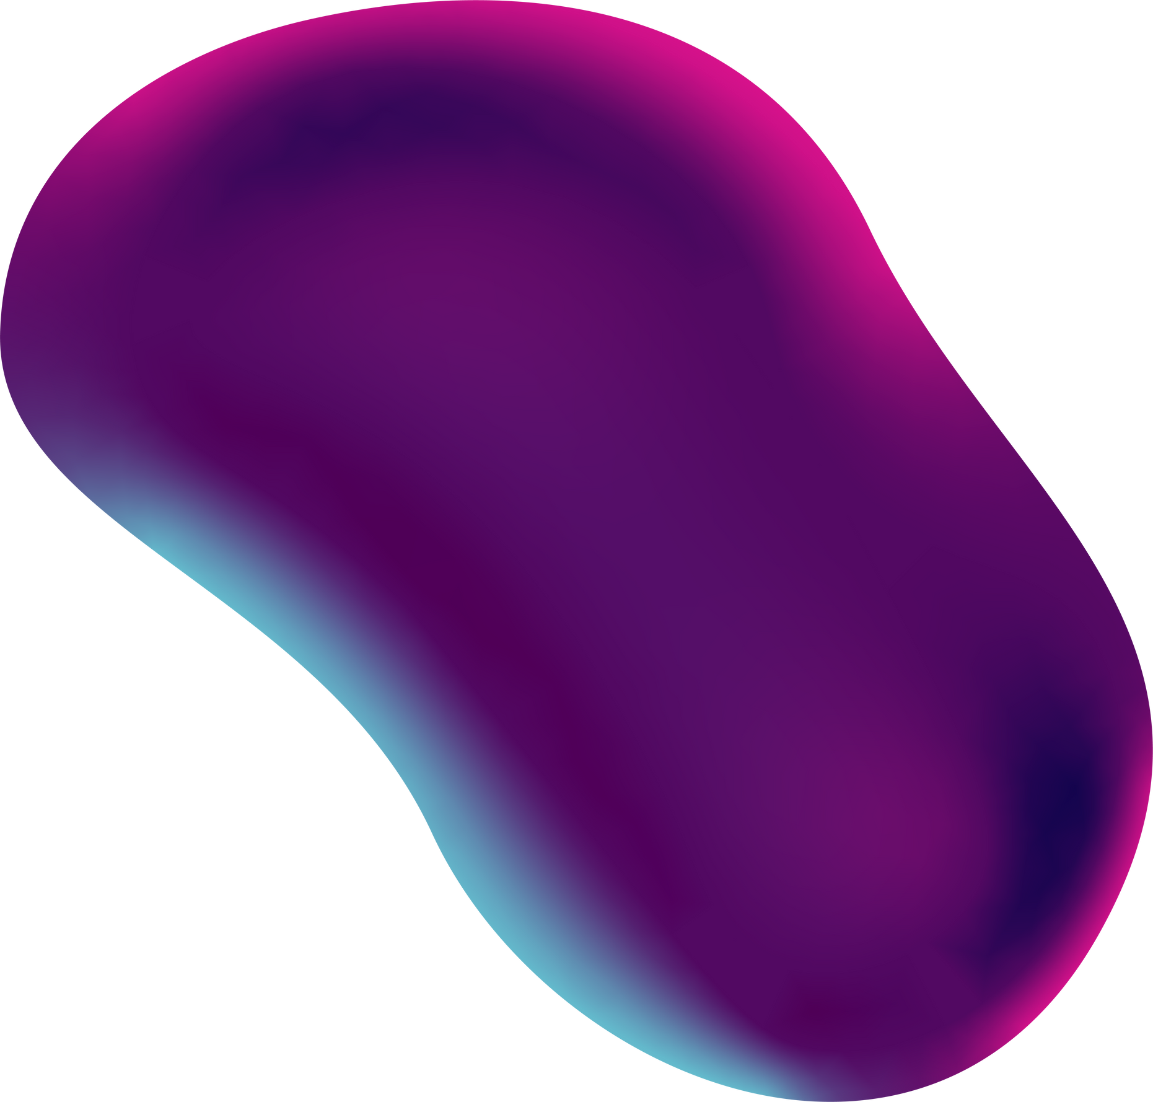
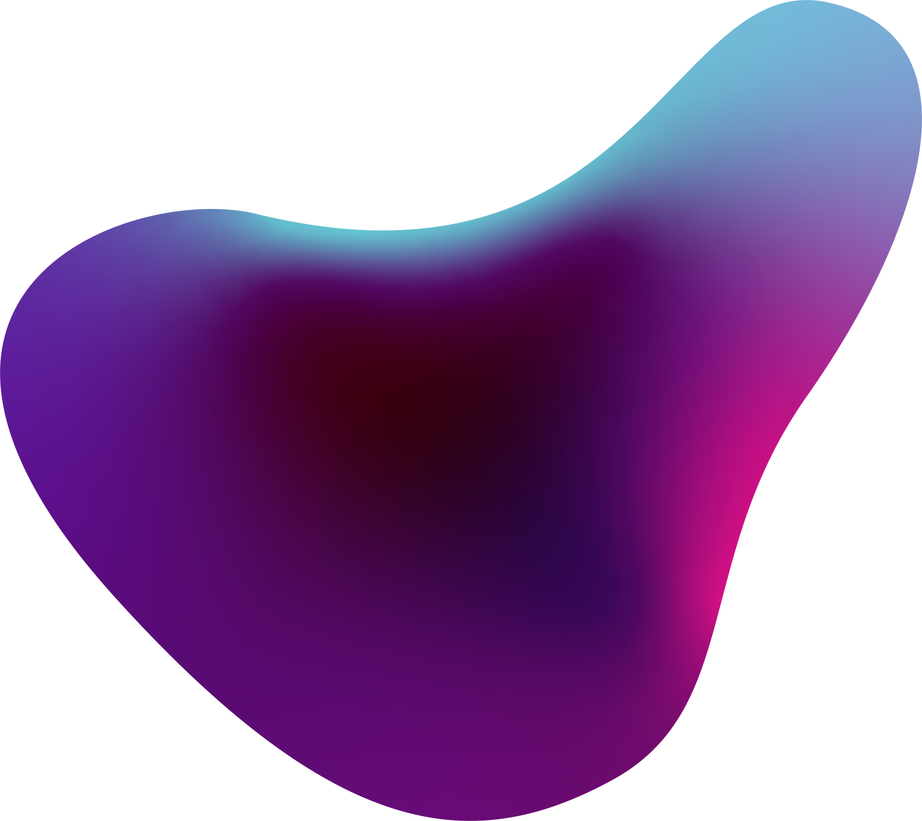
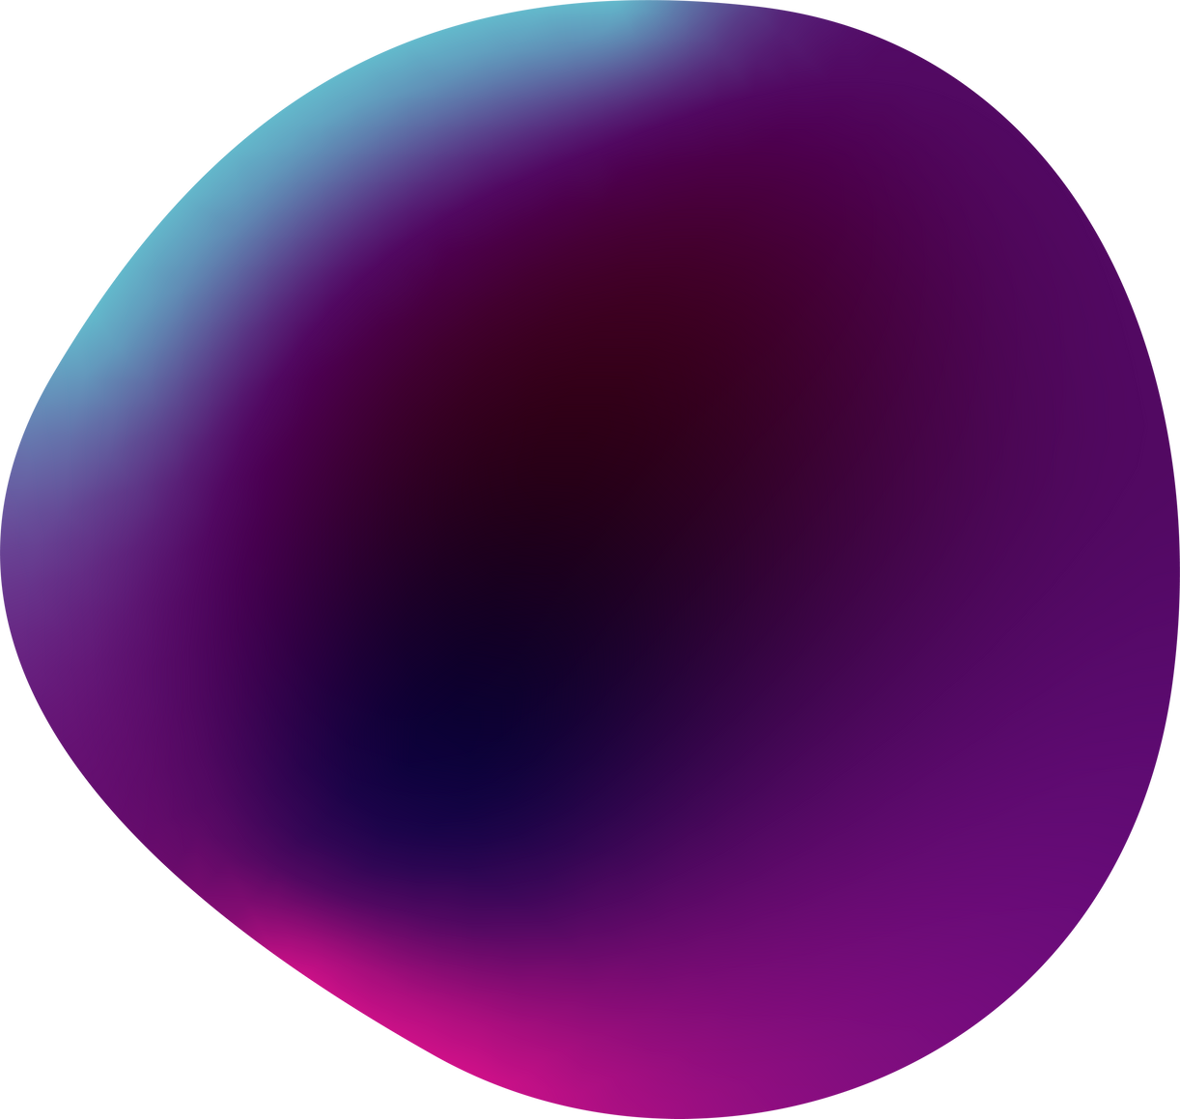
Game Development Process
2D Game Using JavaScript

Slide 2
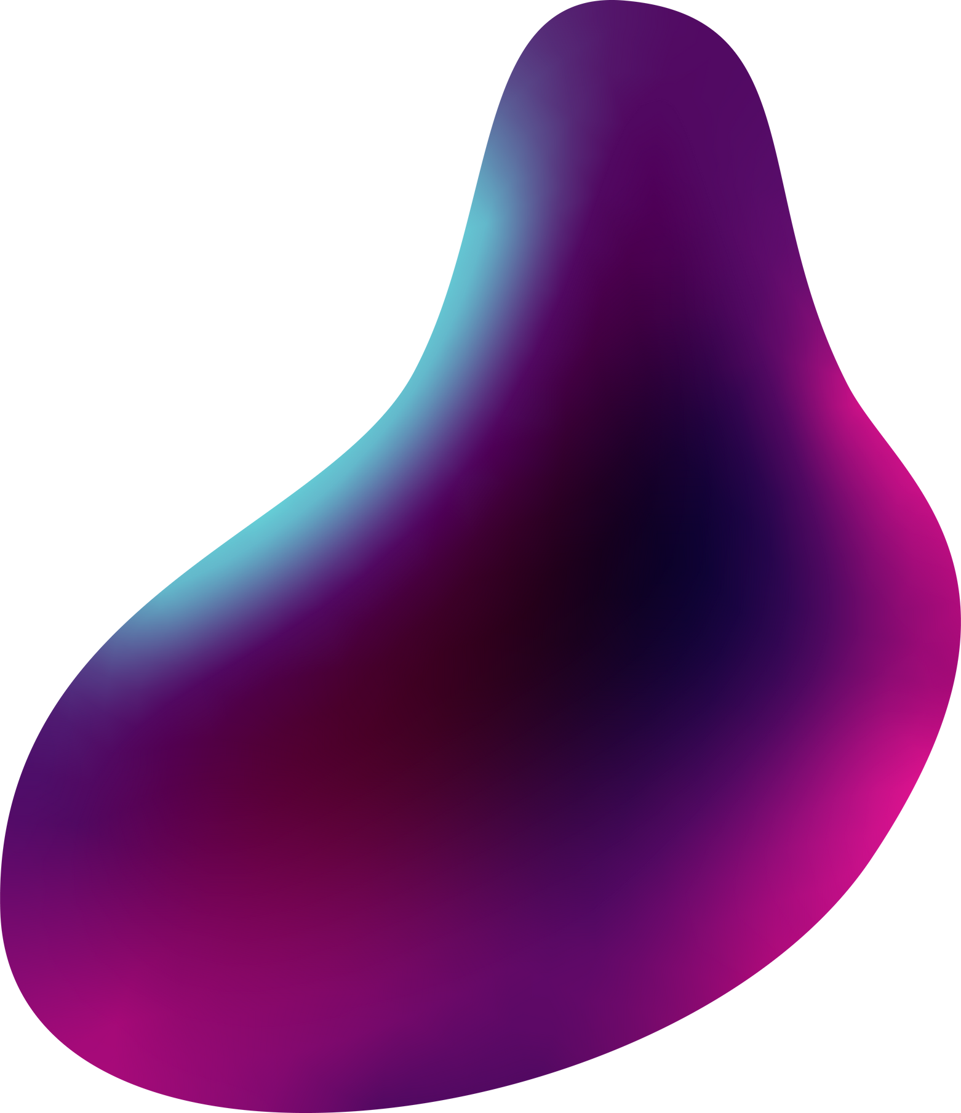
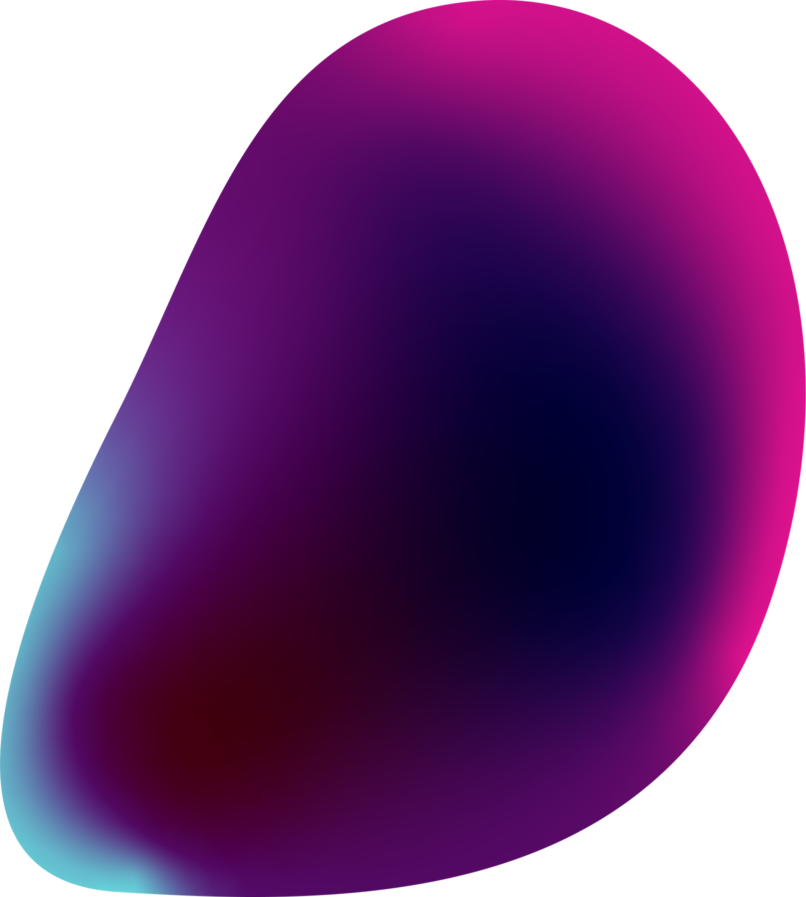
Prashu Shukla(2100910100132)
Prashant Yadav(2100910100131)
TEAM
MEMBERS

Slide 3
Game Development Timeline
STAGE 01
CONCEPT
DESIGN
STAGE 03
DEVELOPMENT
STAGE 02
STAGE 04
STAGE 05
TESTING
DEPLOYMENT

Slide 4
Concept
2D game
Side Scroller like Mario
Runs on Browser
Uses JavaScript
Game Character Ninja
Forest Setting

Slide 5
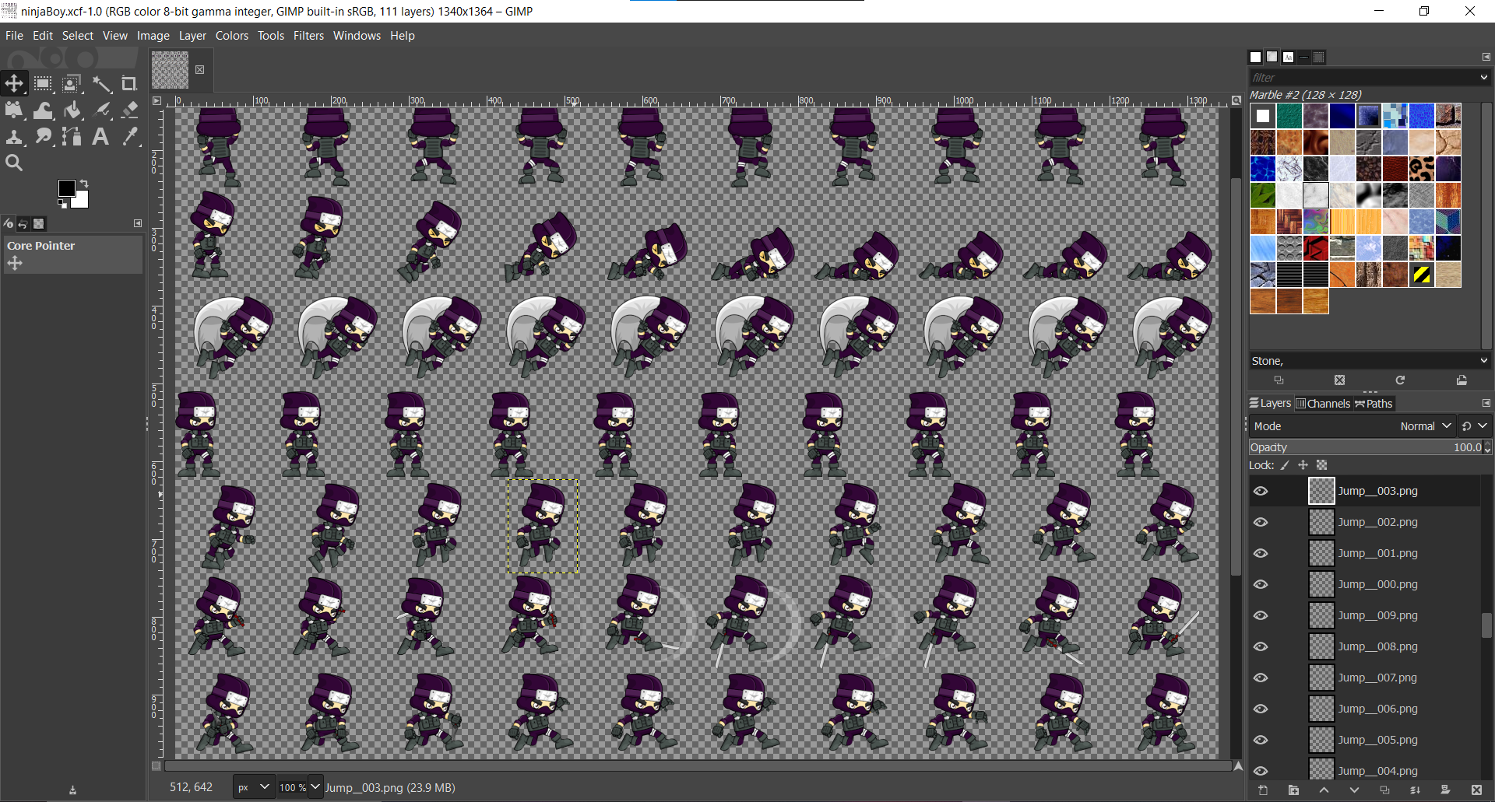
DESIGN (Main character)
Sprite sheet-like character design.
Using Gimp for making frames.
Player facing right side.

Slide 6
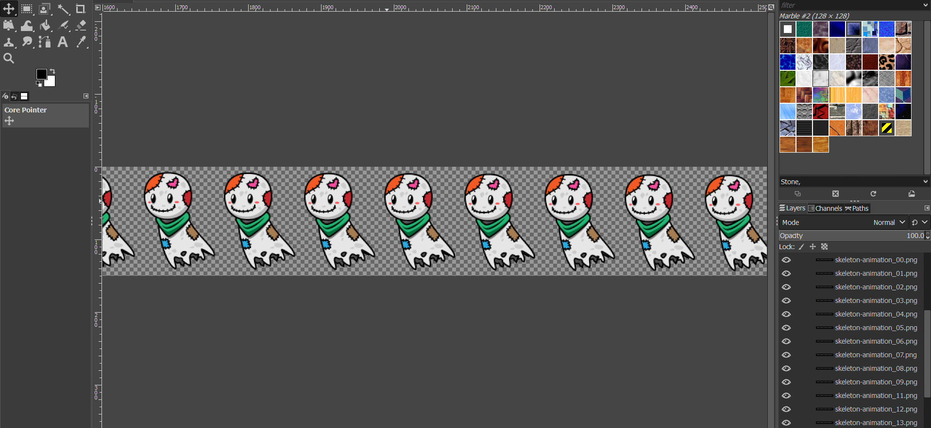
DESIGN (Enemies)
Enemy sprites are designed
facing left.
Such that they move towards the player

Slide 7
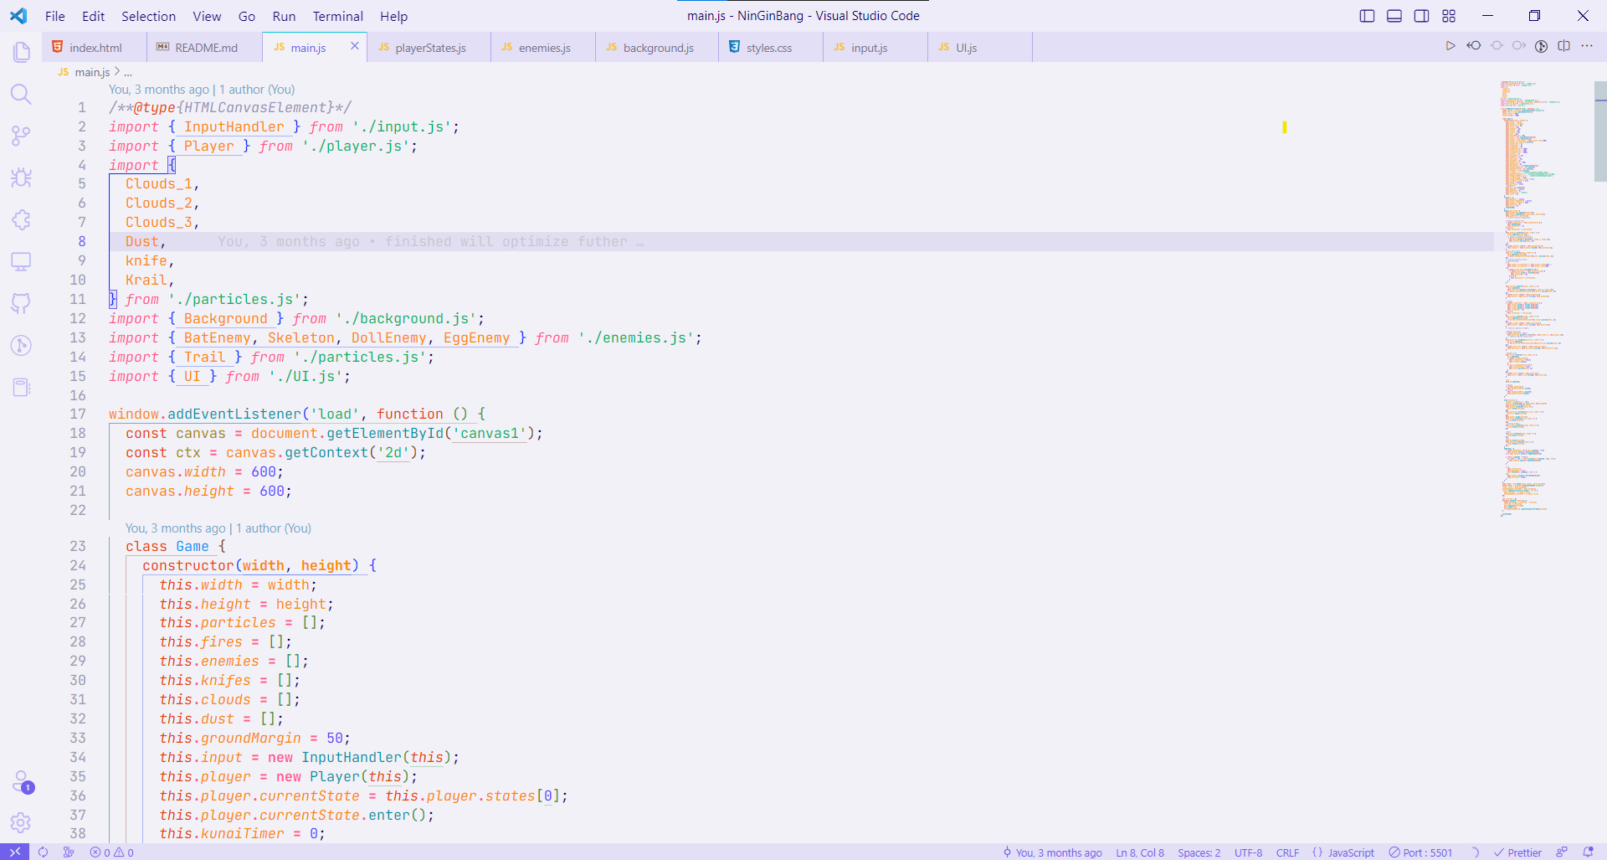
Development
Main Component of Game dev.
Most time is taken in this process.
JavaScript used for Game logic.
HTML Canvas is used as a drawing board.
VS Code IDE used.
Git Version Control.

Slide 8
DEVELOPMENT
Styles.css
background.js
playerStates.js
Index.html
player.js
enemies.js
main.js
UI.js
particles.js
input.js

Slide 9
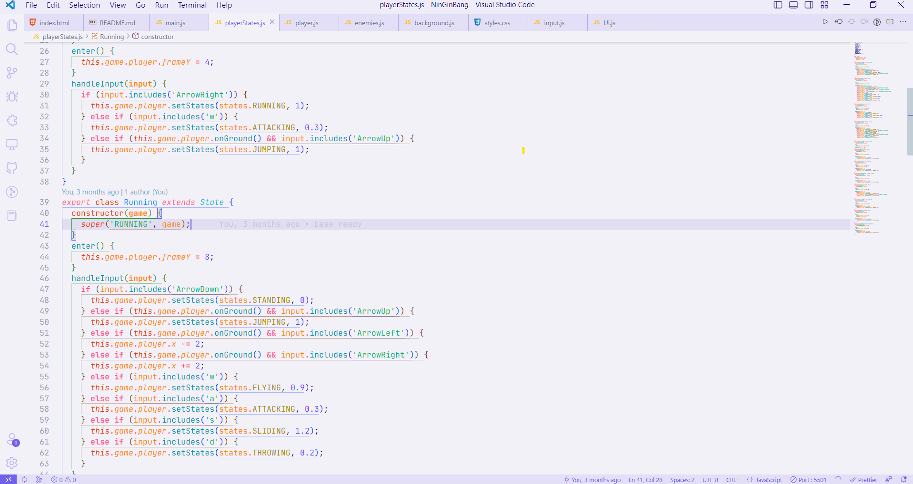
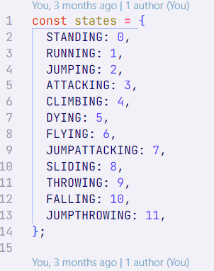
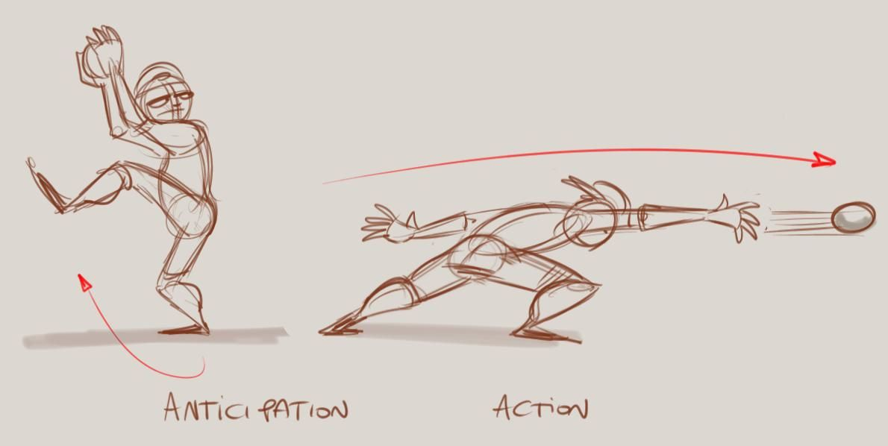
DEVELOPMENT(Player State Management System)
Player state management refers to the process of keeping track of the various states or conditions that a player can be in during a game, such as standing, running, jumping, or attacking.

Slide 10
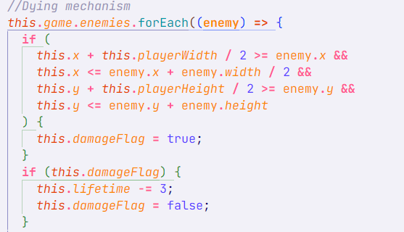
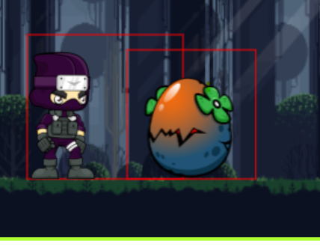
DEVELOPMENT (Rectangular Collision Detection)
To detect collisions between two rectangles, we compare the x and y positions of each rectangle, as well as their widths and heights. If there is any overlap in the x and y axes, and if the width and height of the rectangles overlap as well, then a collision has occurred.

Slide 11
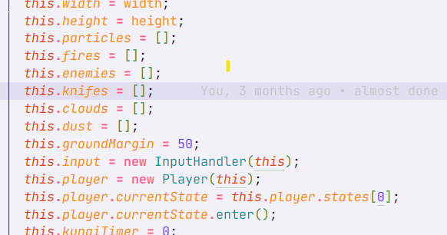
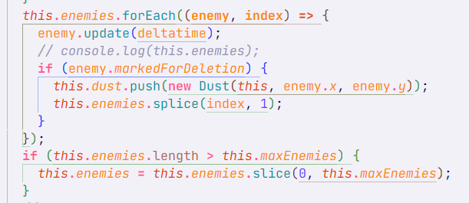
DEVELOPMENT ( Array Data Structure)
Arrays can be used to store and manage game elements, such as sprites or other objects. For example, we can use an array to keep track of all the enemies in a game level, and update their positions and states based on game events.
Arrays can be used to store and manage game state, such as the score, health, and other attributes of the player or other game elements. For example, we can use an array to keep track of the player's health, and update the array based on game events such as collisions with enemies or power-ups.

Slide 12
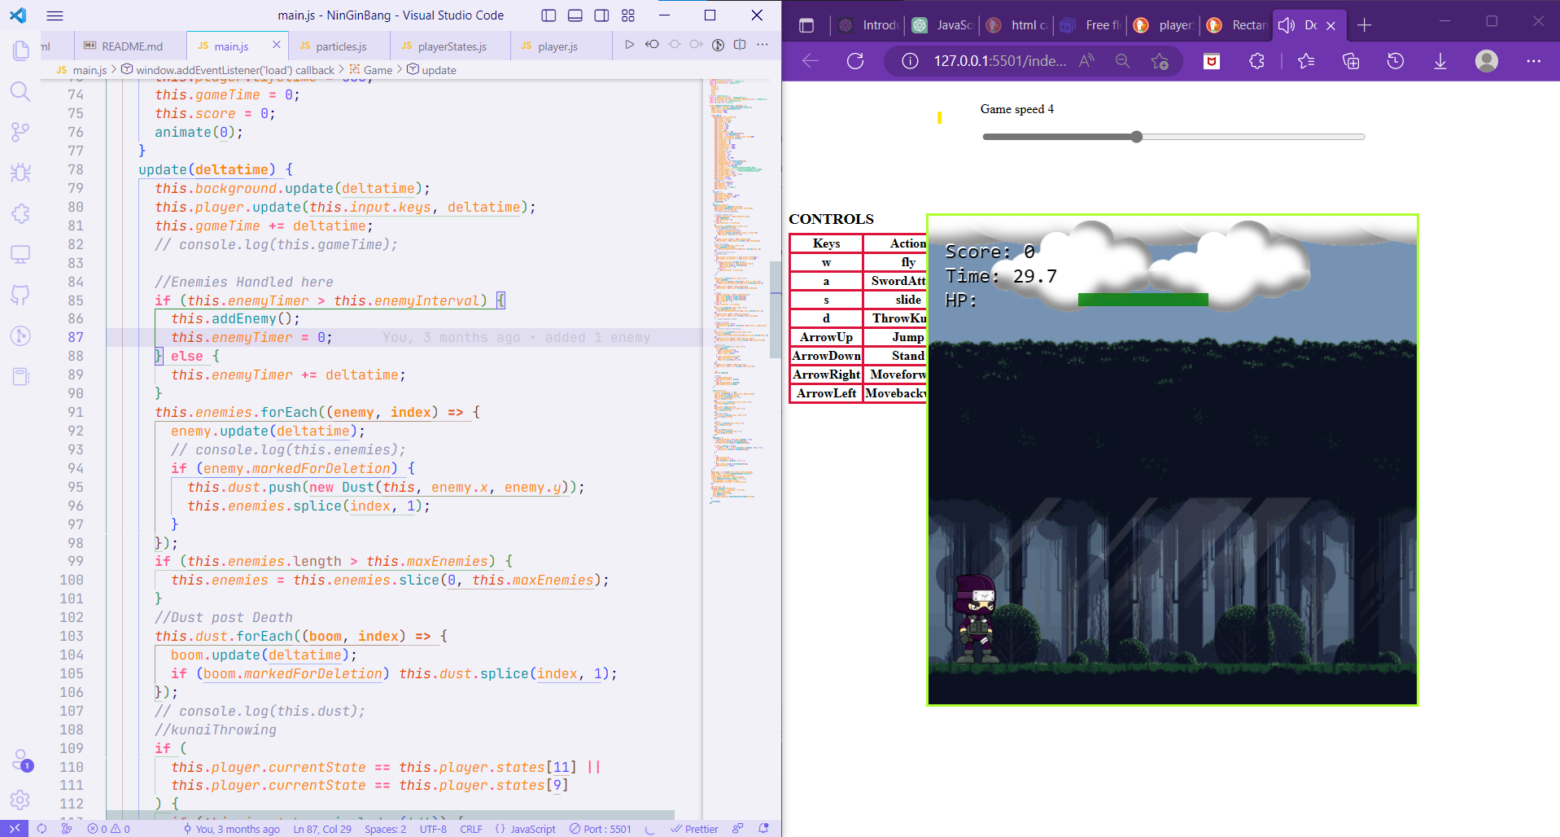
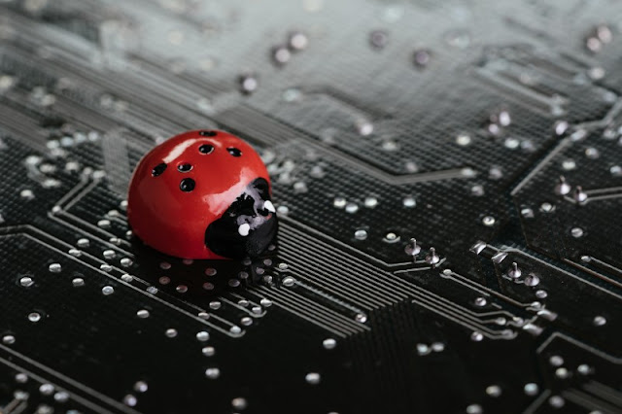
TESTING
The testing phase of game development involves the process of evaluating the game for bugs, errors, and inconsistencies. The goal of testing is to identify and fix issues before the game is released to the public, ensuring a high-quality user experience.
Functionality testing
Compatibility testing
Performance testing
User acceptance testing
Certification testing

Slide 13
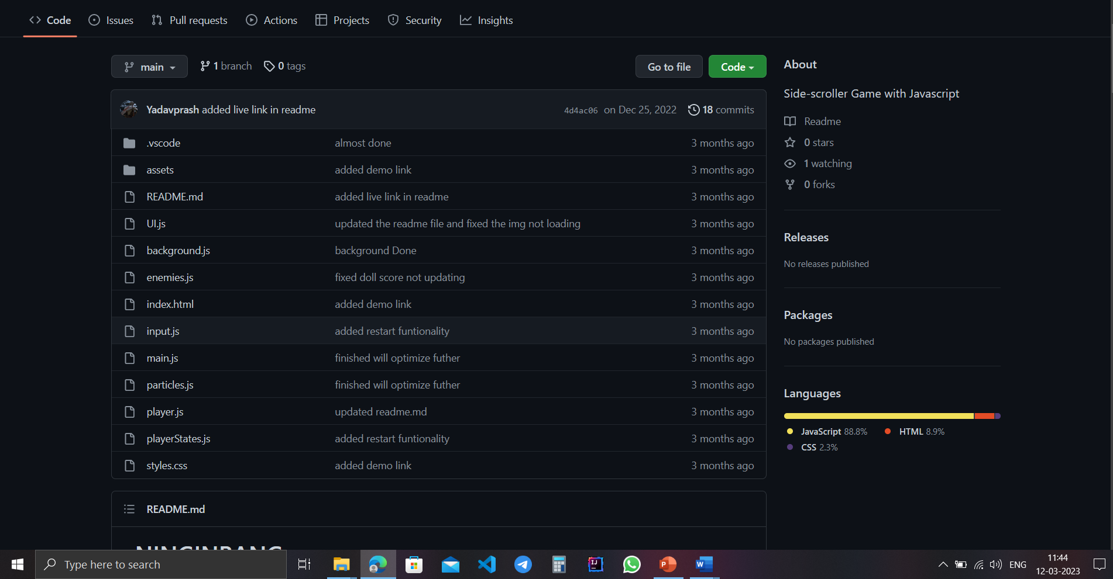
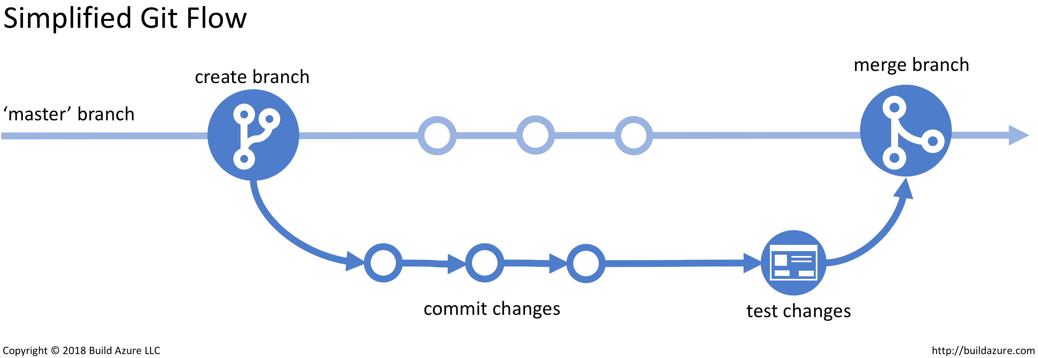
TESTING (GIT VERSION CONTROL)
Git version control can be very useful for 2D game development as it allows multiple developers to work on the same code base simultaneously without overwriting each other's changes. Here are some benefits of using Git version control in 2D game development:
Collaborative Development
Version Control
Branching and Merging
Bug Tracking
When bugs are found during testing, Git can be used to track the bugs and their fixes. This allows you to see what changes were made to fix the bug and ensure that it doesn't come back in the future.

Slide 14
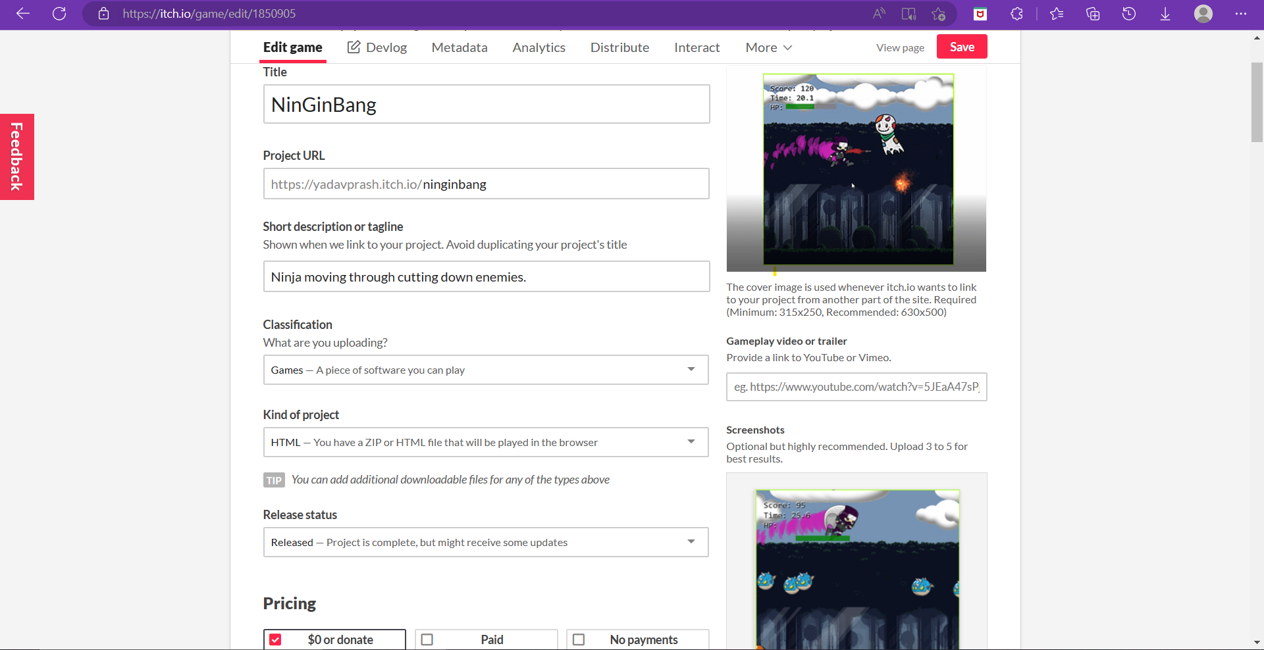
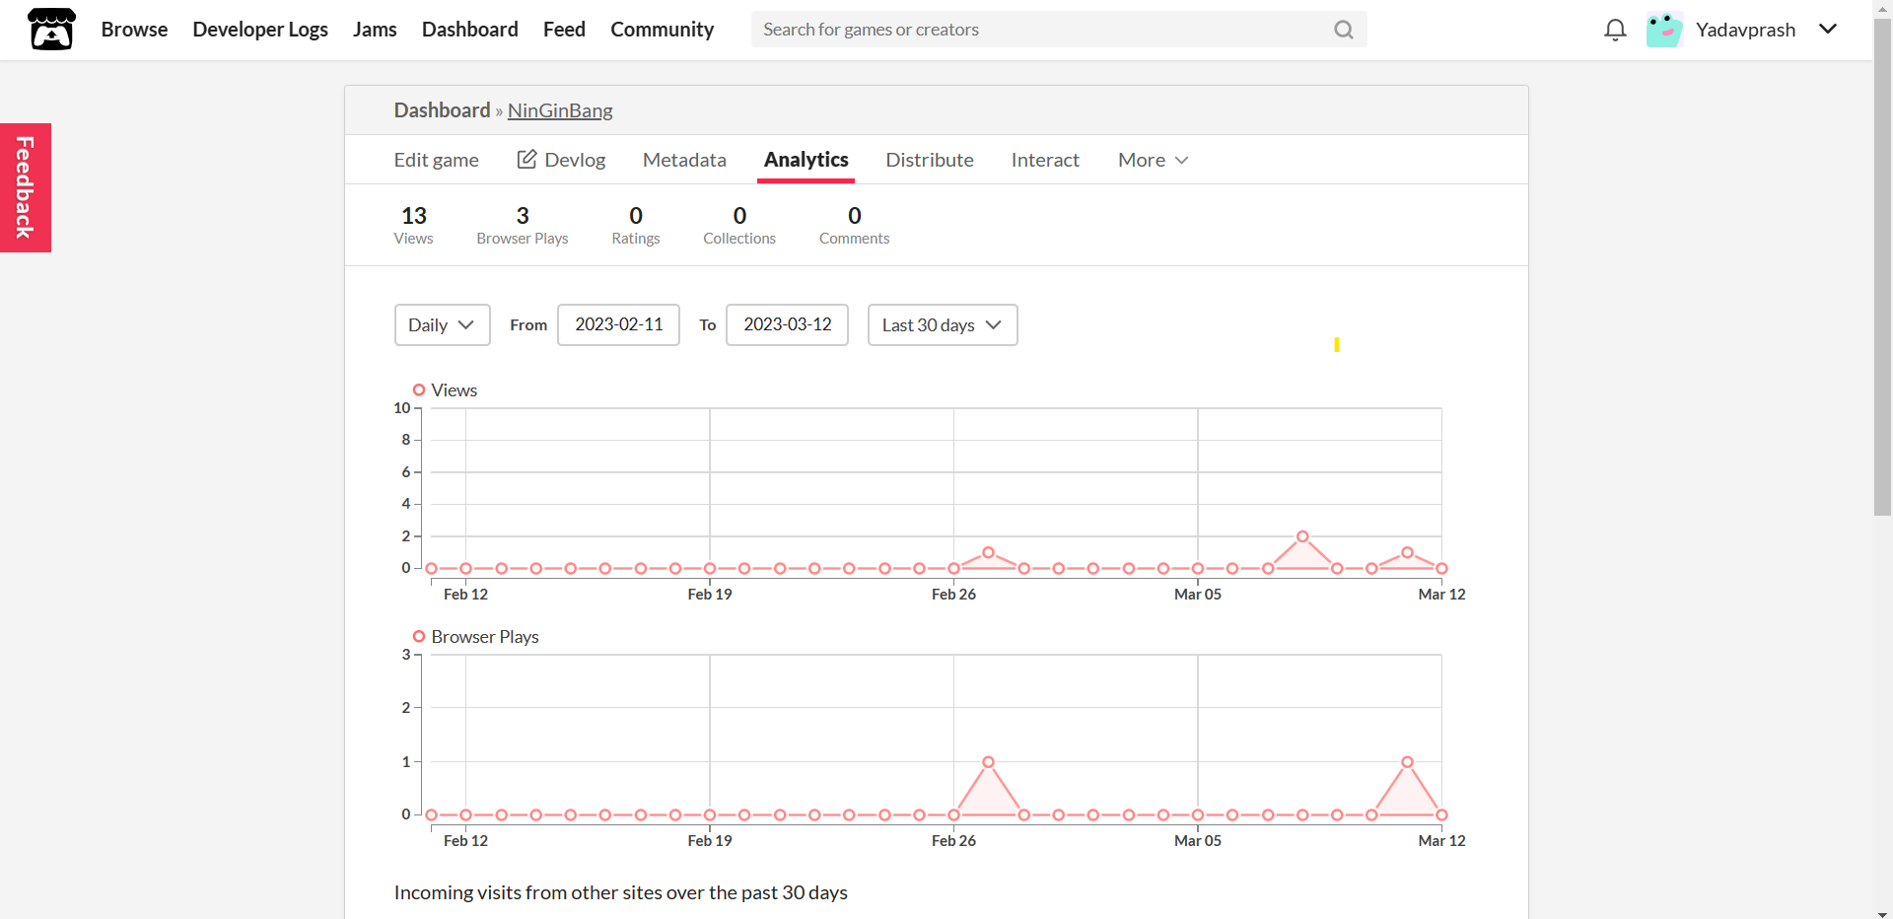
DEPLOYMENT
The project can be deployed on various platforms through steam, epic store, play store, Appstore etc
This project was deployed on itch.io.
It can be played on any browser.
After the game has been deployed, developers will continue to provide ongoing support and maintenance. This may involve releasing updates to fix bugs, adding new features, or addressing player feedback.

Slide 15
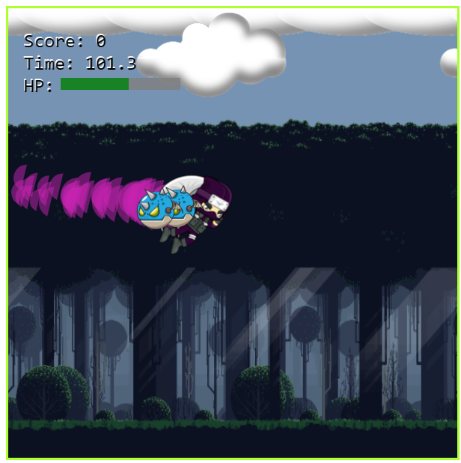
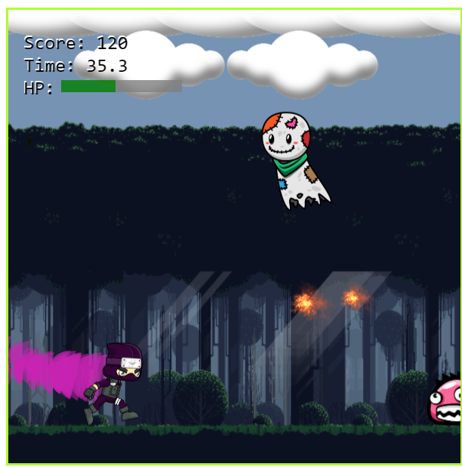
FINAL PRODUCT

Slide 16
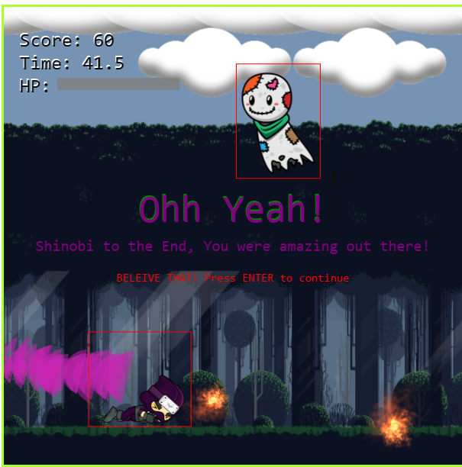
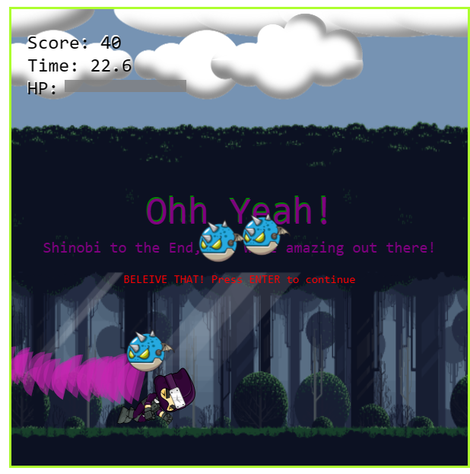
FINAL PRODUCT

Slide 17
THANK YOU

